Slide 1
Introduction to Computational Modeling of Cognition and Behavior

Slide 2
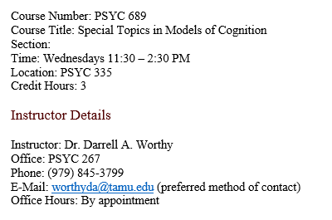
Introductions
Name, department, area, or advisor, what type of research you do

Slide 3
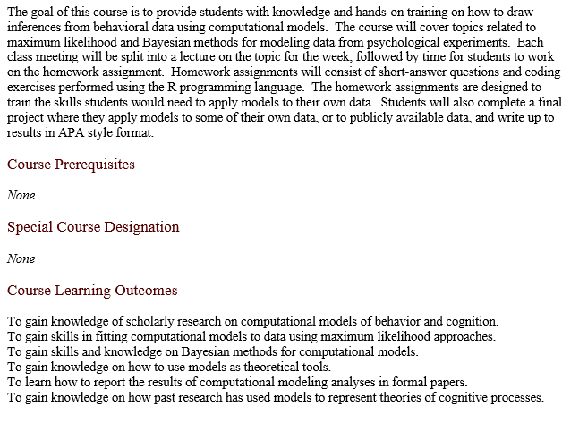
Course overview

Slide 4

Course textbook
The textbook chapters are available on Canvas.
You can also buy the book – a paperback copy is about $50.

Slide 5
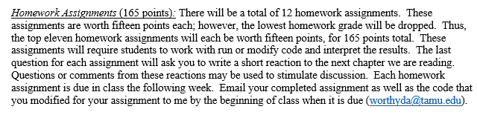
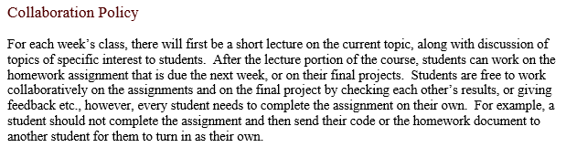
Homework assignments

Slide 6
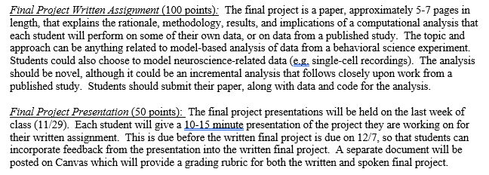
Final project (150 total points)
For the final project each student will complete a modeling project and will both write a short paper and give a presentation during the final week of class on the methods and results of the project.

Slide 7
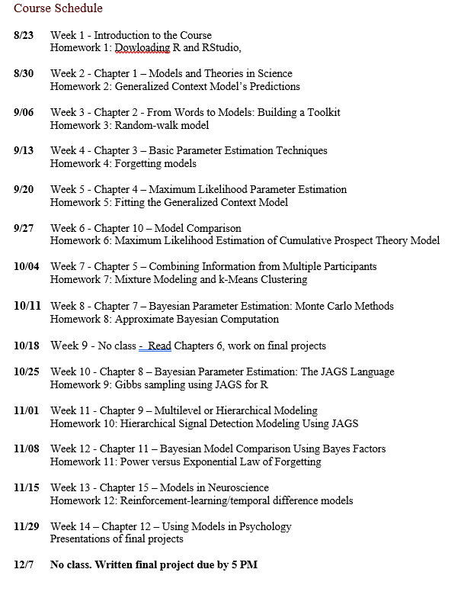

Slide 8
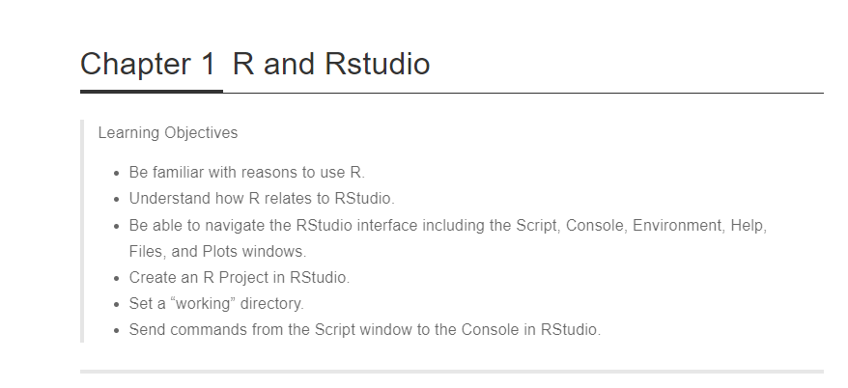
Homework 1
For this homework assignment you will just be installing R and Rstudio.
If you’re new to R, and especially if you’re new to coding, in general, it is recommended that you complete this tutorial, preferably before week 2: https://cengel.github.io/R-intro/

Slide 9
Reactions to chapter readings
It is critical that you fully read each chapter of the textbook.
There will be a short lecture on each chapter, but it is intended as a review of that material.
There are no exams in this course; reading the textbook and completing the homework assignments are the main focus
The last question of each homework asks you to write a 1-2 paragraph reaction.
These might be discussed in class – please indicate if, for some reason, part of your reaction should not be publicly discussed.

