Slide 1
Computational Modeling of Cognition and Behavior
Chapter 1: Introduction

Slide 2
Models in Theories and Science
Describe and predict people’s behavior
Reliance on mathematical models – just like physicists or chemists
Data require a model to be understood and explained
Verbal theorizing cannot substitute for quantitative analysis
Must always select from several possible models
Modelers must rely on intellectual and scholarly judgment, in addition to quantitative evaluation.
  Psychological plausibility, parsimony, falsifiability

Slide 3
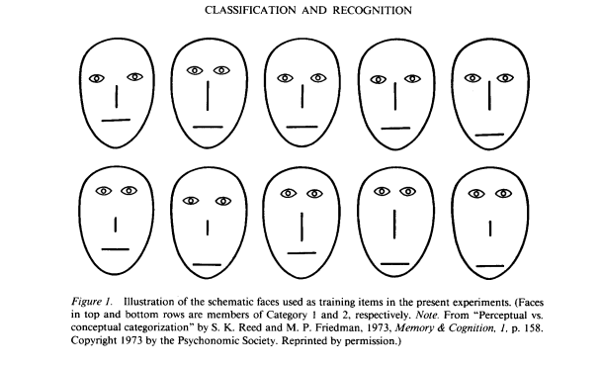
Quantitative Modeling in Cognition
Nosofsky, 1991 – classified cartoon faces into one of two categories
Made classification as well as recognition decisions

Slide 4
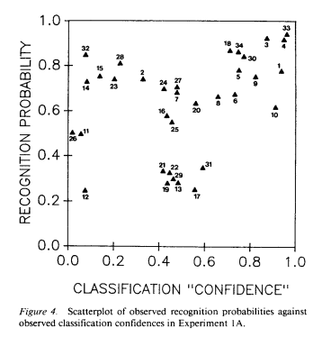
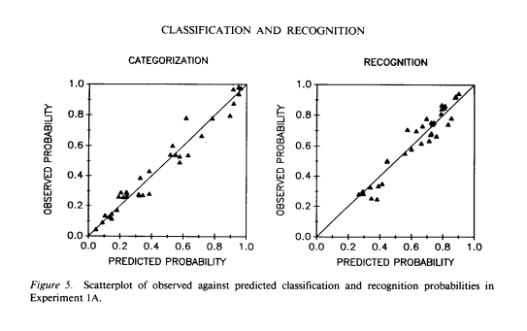
Quantitative Modeling in Cognition
Appears to be no correlation between recognition and classification confidence.
But Nosofsky’s Generalized Context model (GCM) can predict both

Slide 5
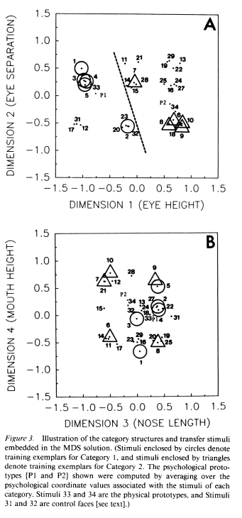
Quantitative Modeling in Cognition
To model these data, the stimuli were first sorted along four dimensions using multidimensional scaling (Kruskal, Young, & Seery, 1973)
The dashed line indicates the bound between the circle and triangle categories.
Sometimes the first step in modeling is to simply get the data into a quantitative form.

Slide 6


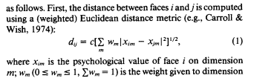
Quantitative Modeling in Cognition
In the GCM, stimuli that are closer to each other are more similar.
A simple distance formula is used to determine similarity.

Slide 7
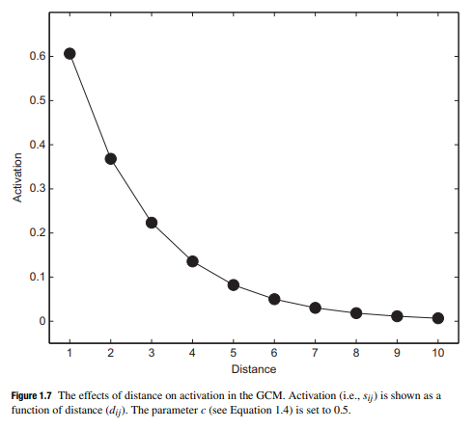
Quantitative Modeling in Cognition
Distance follows Shephard’s (1987) generalization gradient (or law).
The discriminability between two stimuli increases exponentially

Slide 8
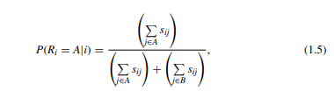
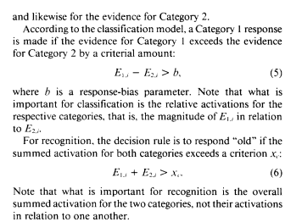
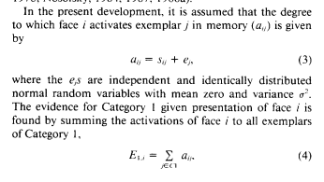
Quantitative Modeling in Cognition
The probability of classifying a stimulis into category A is determined by the summed similarity of that stimulus to category A stimuli.
Nosofsky (1991) uses summed similarity in a slightly different way for classification and recognition choices.

Slide 9
Quantitative Modeling in Cognition
Activation, based on summed similarity, from the GCM could predict both categorization and recognition probabilities.

Slide 10
Descriptive Models
One main distinction between modeling approaches is whether the models are used to describe data, such as by comparing differences between groups.
Or, whether models are being used to represent theories about cognitive processes.
Heathcote et al. (2000) – Power law does not describe data as well as exponential law of skill acquisition.
Descriptive models have no intrinsic psychological content.

Slide 11
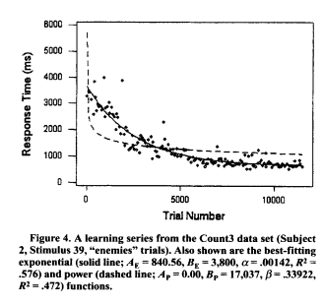
Descriptive Models

Slide 12
Cognitive Process Models
The GCM is a cognitive process model.
Doesn’t just describe data
Makes theoretical claims about how stimuli are perceived (Shephard, 1987)
  Claims that categorization is an exemplar process – not a prototype of rule-based process.
  Claims that people can selectively attend to one dimension.
  Also claims that people use summed similarity, rather than average similarity.

Slide 13
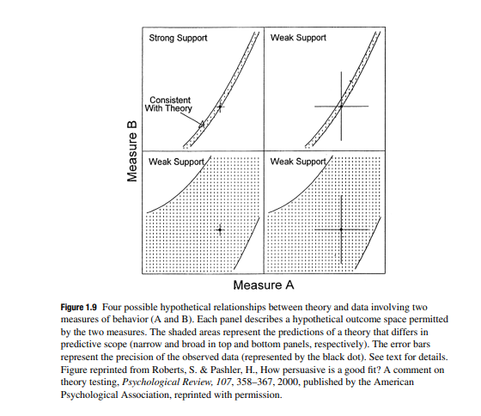
Potential Problems: Scope and Falsifiability
A model should have just the right scope
  Can predict the pattern of the data
  But, cannot predict every pattern.
Particularly true for cognitive process models.
Models need to be falsifiable, or testable.

Slide 14
Modeling as a “Cognitive Aid” for the Scientist
Models help us communicate in specific ways
“Similarity” or “activation” or “selective attention” can mean different things if only words are used.
A model gives us precise operational definitions.
Models can also be used to make specific predictions
Using models as a tool can help us go beyond mere verbal theorizing, which is less precise.

Slide 15
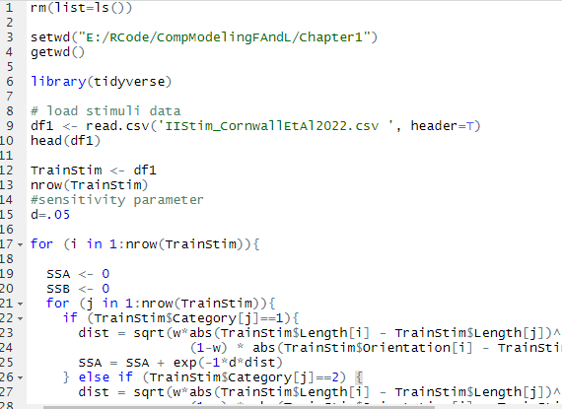
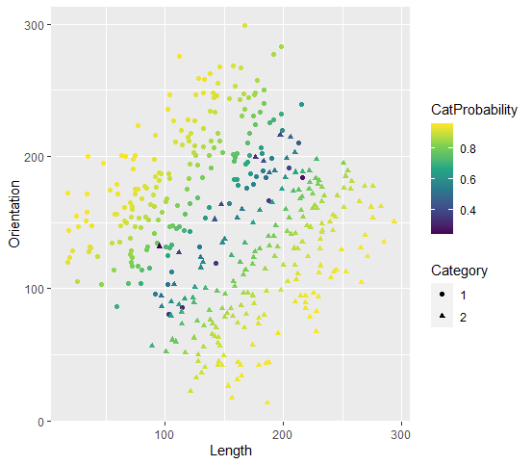
Homework for Chapter 1
Will be examining how the exemplar model makes predictions about how likely it is each stimulus will be correctly classified.

Slide 16
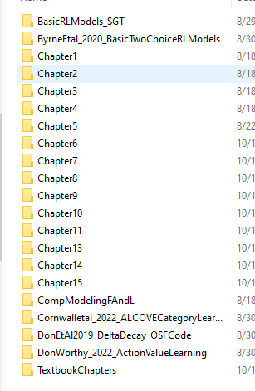
Model Data Sets and Code
BasicRLModels_SGT – Fits many models for tasks like the IGT and SGT – fit to Don et al., 2022 NBA data
Byrne_etal2020 – Fits Basic two choice RL models – also uses regressors in multilevel models
Cornwall et al., 2022 – Fits and simulates ALCOVE, connectionist model of category learning
Don et al., 2019 – Fits models to the ABCD task used to test predictions of Delta vs. Decay RL models
Don & Worthy – 2022 – follow-up to 2019 Don et al. paper

