Slide 1
Doing Bayesian Data Analysis with R and JAGS
Examples from Kruschke text
Darrell A. Worthy
Texas A&M

Slide 2
Download the latest version of R
This tutorial was written with R version 3.4.
You can download it here https://cran.rstudio.com/
Also download the latest version of Rstudio https://www.rstudio.com/products/rstudio/download2/
Download JAGS at: https://sourceforge.net/projects/mcmc-jags/?source=typ_redirect
Once JAGS is installed, invoke Rstudio, and on the command line type: install.packages(“rjags”) and install.packages(“runjags”)

Slide 3
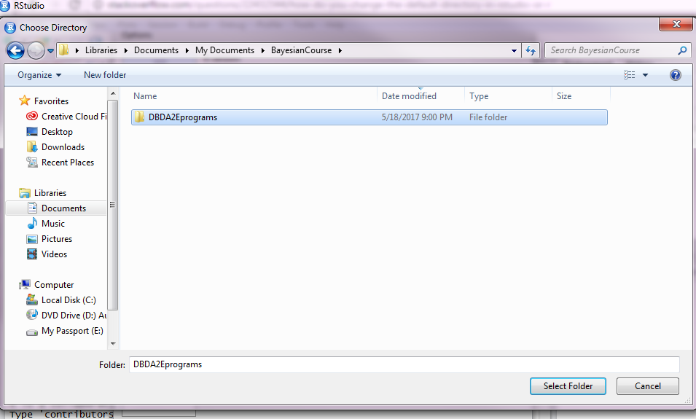
Setting default working directory in R
This is optional but I will set the default working directory as the folder DBDA2EPrograms folder, since that is what we will be working on.
  The other option is to use the setwd() function
Click on Tools, then Global Options, then under Default Working Directory.
Click Browse and navigate to the DBDA2EPrograms, click Select Folder and then Apply.

Slide 4
Stan
Kruschke uses JAGS and Stan to do much of the same analyses.
Due to the short nature of this course and Stan’s somewhat intensive installation process I will just be showing a few examples using JAGS.
Stan is the most cutting edge MCMC interface with RStan devoted to interfacing with Stan and Rstanarm devoted to taking many common R commands such as lm or glm and translating them into Bayesian analyses.
To download Rstan go to: https://github.com/stan-dev/rstan/wiki/RStan-Getting-Started.
You can then use Kruschke’s Stan code along with the JAGS code.

Slide 5
Regression using JAGS
We used JASP to analyze the Worthy, Byrne, & Fields (2014) data on worry predicting decision-making behavior more than anxiety and mood.
One thing we did not get from JASP were regression coefficients.
We might like to report these and want to do so without having to use point estimates from OLS analysis.
JASP allows us to test hypotheses and we got clear evidence that worry was the biggest and only predictor.
However, if we have more applied goals we might want to examine the posterior distributions for our Regression coefficients.
JASP also did not directly tell us R² values, and these analyses will give us something similar.

Slide 6
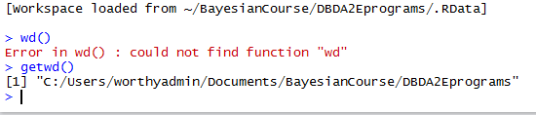
Regression using JAGS
Type getwd()
It should indicate that you are in the DBDA2Eprograms folder.
If not the use setwd() to switch to the correct wd.

Slide 7
Regression using JAGS
In Chapter 18 of the Kruschke text there is an example on multiple regression using two predictors.
The data come from Guber 1999; the DV is the average total SAT score per state, the predictors are amount spent per pupil on SAT instruction, and the % of students taking the test.
Amount spent is negatively correlated with SAT scores, but this is because amount spent is correlated with % of students taking the test.
  This negative correlation for amount spent might lead some people to argue against public spending for education.
As more mediocre students are encouraged to take the SAT scores drop, therefore the % of students taking the test could be the underlying cause.

Slide 8
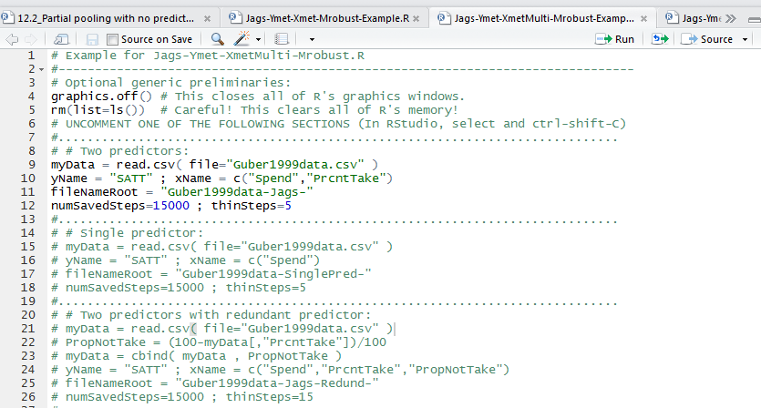
Regression using JAGS
In RStudio click on the open file icon in the top left and open Jags-Ymet-XmetMulti-Mrobust-Example.R
These scripts that end in Example can be used to conduct similar analyses.
Lines 9 and 10 list the filenames and variables.
You can resave this R file and type in your file and variable names here to run your own multiple regression.

Slide 9
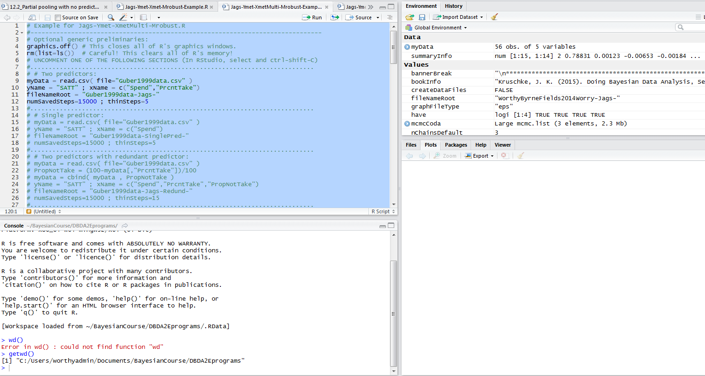
Regression using JAGS
Now click on the file editor window and press Ctrl+A to highlight all
Once it is highlighted press Ctrl+R to run the file.

Slide 10
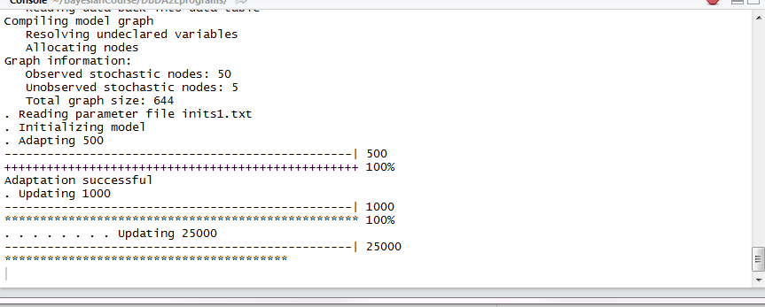
Regression using JAGS
You should see it tell you what it’s doing during the run.

Slide 11
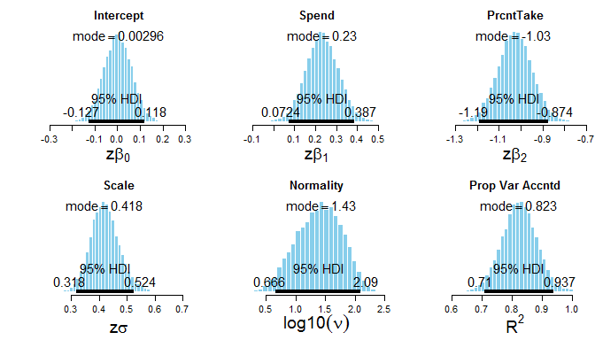
Regression using JAGS
If it runs successfully then you should see about 13 R Graphics windows showing various things.
The top most (Device 13 if no graphics windows were open), shows standardized regression coefficients and R².

Slide 12
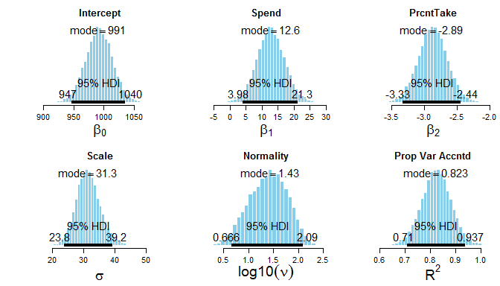
Regression using JAGS
The next plot (12) will show the unstandardized coefficients.
From this and the previous plot we could get the 95% HDI (with plots) for our regression coefficients.
Scale and Normality refer to the likelihood function used and are of less interest to us; a Bayesian analogue of R² can also be reported.

Slide 13
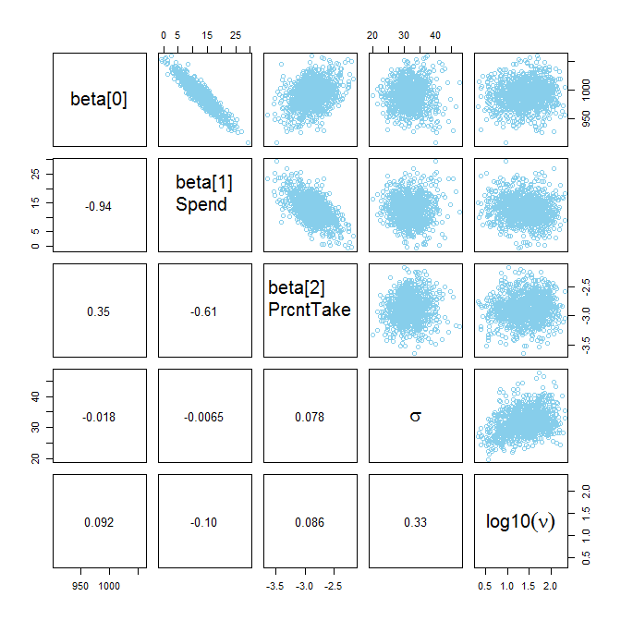
Regression using JAGS
Device 11 will show pairwise plots of credible parameter values from the MCMC chain (not scatterplots).
We can see that Spend and PrcntTake trade off.
Note that these are not scatterplots, but correlations from MCMC sampling.

Slide 14
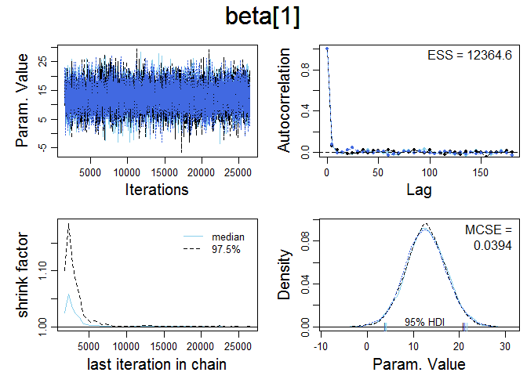
Regression using JAGS
The remaining plots will show MCMC diagnostics for each parameter value.
The top left panel shows the random walk after the burn-in period.
These parameter estimates should converge to random walks around a modal value (the chain should not be all over the place).

Slide 15
Regression using JAGS
The top right and bottom left plots should asymptote as they do in this example.
ESS means effective sample size and larger is better.
The bottom right shows a posterior predictive check where the posterior distribution is shown with simulated values superimposed by the dashed line; these lines should be close to each other.

Slide 16
Regression using JAGS
These high level scripts that end in Example can be modified to run your data.
In Rstudio open Jags-Ymet-XMetMulti-Robust-WorthyByrneFields2014.R
I made this file by saving Jags-Ymet-XmetMulti-Robust-Example.R with a different name that included my data.
I then modified the data file and variable names and saved.
  (in computer programming it’s usually faster to start from an existing file than from scratch).
Note that your variable names in your .csv file cannot have any spaces.

Slide 17
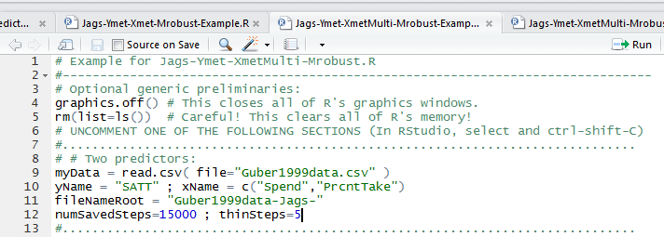
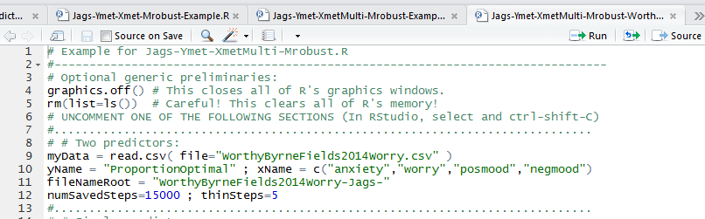
Regression using JAGS
Let’s compare the old file with the one I have resaved.
On line 9 you can see I changed the data file name (make sure your data is in the working directory so it can call the file).
On line 10 I have changed yname and xname (c means combine)
On line 11 I have changed the fileNameRoot

Slide 18
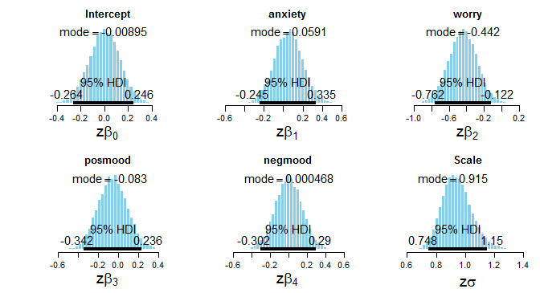
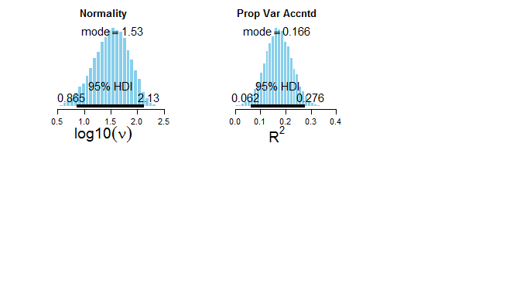
Regression using JAGS
Now let’s press CTRL+A and CTRL+R to see if we can run the analyses on this data set.
You should get about 19 R Graphics device windows this time.
You can see the standardized coefficients; how many parameters have 95% HDIs well away from zero?

Slide 19
Summary
I highly recommend the Kruschke text if you think you would like to start conducting Bayesian data analyses.
Chapters 16-24 cover examples using different types of data that cover all the analyses you have learned about in ANOVA and Regression courses as well as some more advanced topics.
My recommended practice is to report Bayes factors using JASP as alternatives to NHST.
Use R and Jags (or Stan) to provide additional data on particular parameter estimates that are not currently available with JASP.
We’ve seen how easy it is to use R and JAGS, and it’s worth a little extra analysis for a paper that will be in the published literature forever.
Arguably JAGS is more necessary for regression with metric predictors than for ANOVA since we do not normally use coefficients to describe main effects or interactions.

Slide 20
Regression using JAGS
Now it’s time to try some Bayesian data analysis on your own data!
I recommend first analyzing them with JASP and then possibly trying to resave and modify the Jags example file that best fits your data.
JAGS files start with specifying the scale of the y variable (binom, count, dich, met (metric), nom (nominal), ordinal).
They then specify the scale of the x variable(s) and how many variables there are.
The files ending in Example are the ones you want to use.
If you run into problems first try to resolve it on your own as that will better help you learn than someone giving you the answer.

